Slide 1
Analysis on Oakland Crime Statistics
Jiarong Ye, Han Shao, Yichi Qian
DS 220

Slide 2
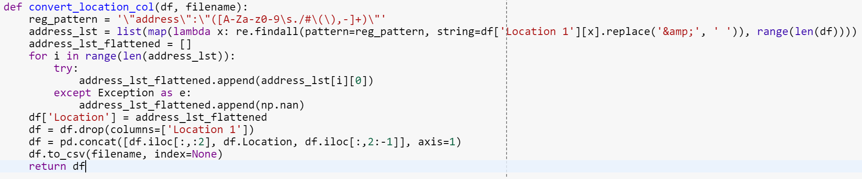
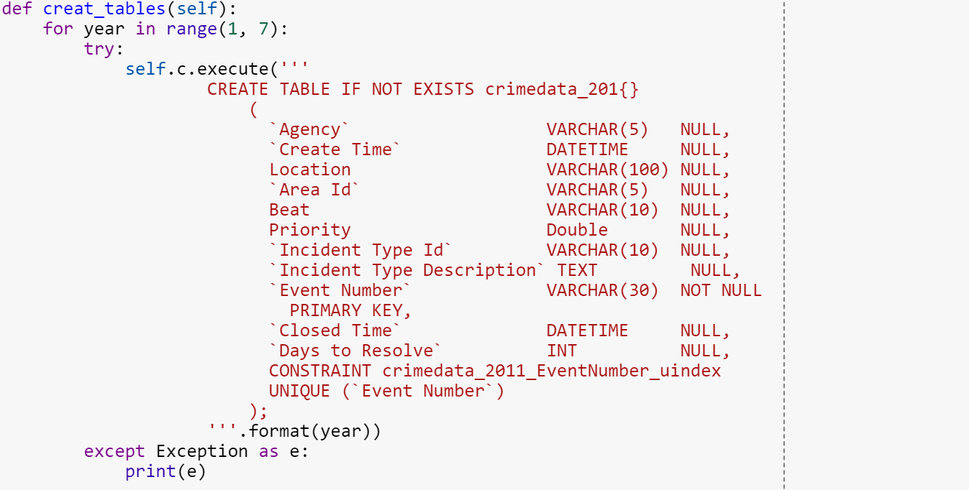
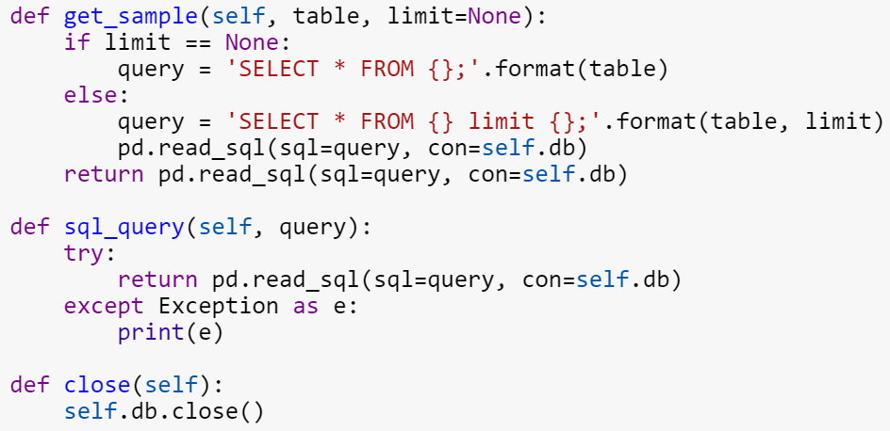
How we process the raw data
Formatting the address
Load data into Mysql
Load data into Mysql(Cont.)

Slide 3
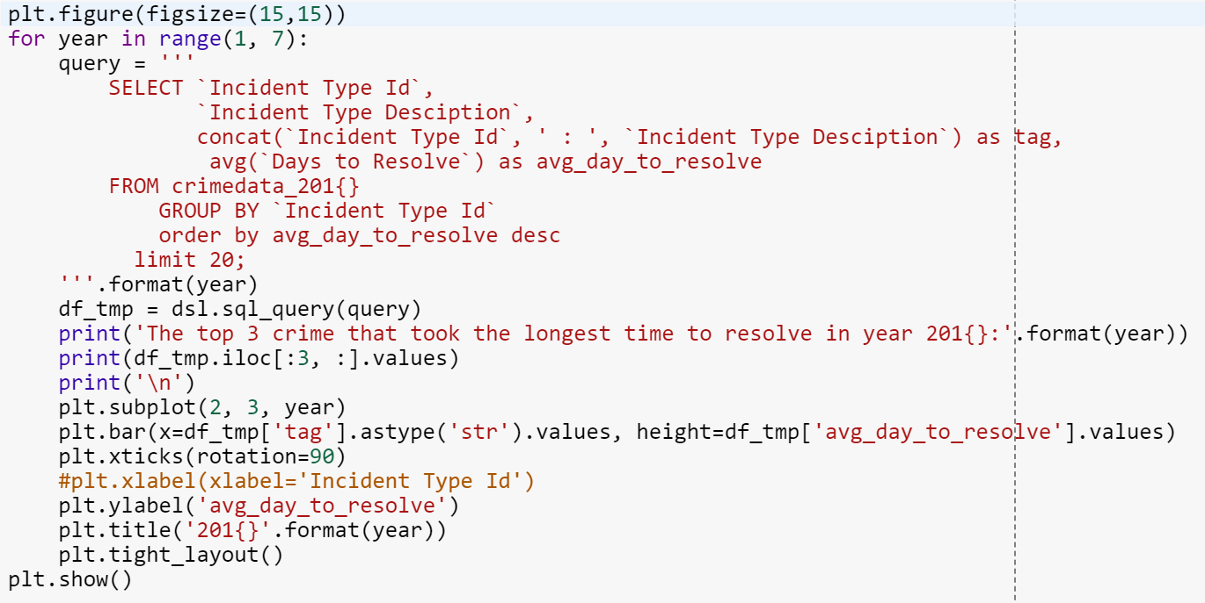
How we process the raw data(Cont.)
Sample code of the plotting

Slide 4
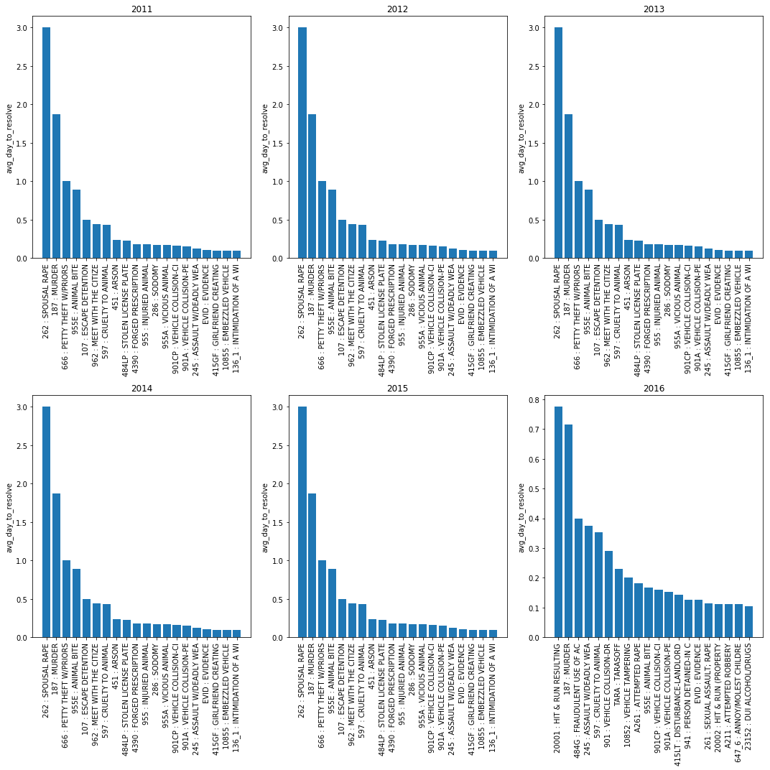
Ranking of Crime Type of Each Year

